Slide 1


Technician Licensing Class
Lesson 1
presented by the
Midland Amateur Radio Club
Midland, Texas

Slide 2
FCC Rules
Subelement T1

Slide 3
Why Amateur Radio?
The basis & purpose of the amateur service consists of five principles:
Recognition and enhancement of the value of the amateur service to the public as a voluntary non-commercial communication service, particularly with respect to providing emergency communications.
Continuation and extension of the amateur’s proven ability to contribute to the advancement of the radio art.
Encouragement and improvement of the amateur service through rules which provide for advancing skills in both the communication and technical phases of the art.

Slide 4
Why Amateur Radio? (Cont'd)
Expansion of the existing reservoir within the amateur radio service of trained operators, technicians and electronics experts.
Continuation and extension of the amateur’s unique ability to enhance international goodwill.

Slide 5
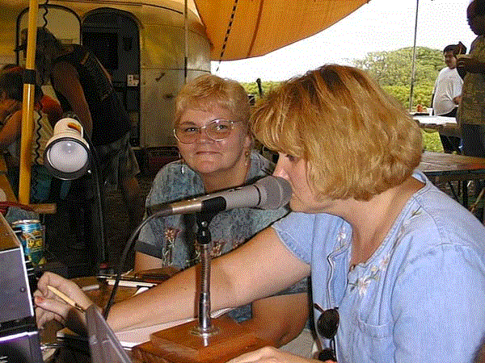
Amateur Radio Licenses
Technician
Technician w/ Morse Code
General
Amateur Extra

Slide 6
Amateur Radio Licenses (Cont'd)
The FCC must grant you an operator / primary station license before you can operate
As soon as your license appears in the database you may transmit
Ten Year Term
Renew no more than 90 days before expiration
Two Year Grace Period for renewal after expiration
Renewals / Changes on FCC Form 605

Slide 7
VHF/UHF Amateur Bands
Frequency Limits in ITU Region 2:
6 Meter Band: 50.0 to 54.0 MHz
2 Meter Band: 144.0 to 148.0 MHz
1.25 Meter Band: 222.0 to 225.0 MHz
70 CM Band: 420.0 to 450.0 MHz
33 CM Band 902 to 928 MHz
23 CM Band 1240 to 1300 MHz
13 CM Band 2300 to 2310 MHz
and 2390 to 2450 MHz

Slide 8
HF Amateur Bands
  Frequency Limits for Technician Operators with Morse Code in ITU Region 2:
  80 Meter Band 3675 to 3725 kHz
  40 Meter Band 7100 to 7150 kHz
  15 Meter Band 21.100 to 21.200 MHz
  10 Meter Band 28.100 to 28.500 MHz

Slide 9
Qualifying for a License
Anyone can become an amateur licensee except a representative of a foreign gov't.
There are no minimum or maximum age limits
Element 2, a 35 question multiple choice exam, must be passed for a Technician amateur license.

Slide 10
Testing
A Volunteer Examiner (VE) is a an amateur, accredited by a Volunteer Examiner Coordinator (VEC), who volunteers to administer amateur license exams.
A Certificate of Successful Completion of Examination (CSCE) is issued for each exam element you pass.
The 5 WPM morse code test is called Element 1.

Slide 11
More Testing!
A CSCE for Element 1 is only valid for 365 days for upgrade purposes.
A disabled applicant could take Element 1 by using a vibrating surface or flashing light.
Keep CSCE's in a safe place, particularly for Element 1. It is the only document showing authorization to use frequencies below 30 Mhz for a Technician licensee.

Slide 12
Amateur Radio Call Signs
Your call sign must be transmitted to identify your amateur station.
The FCC assigns call signs by the ITU prefix letters, call district numeral, and a suffix in alphabetic order.
In the U.S. call signs begin with A, K, N, or W and have a single digit between 0 and 9
Typical valid call signs: KB3TMJ, K5RS, N5UGH, WB5GVE, AA1B

Slide 13
More on Call Signs
Technician Class operators receive Group C and D format calls, i.e. 1-by-3 and 2-by-3
You may request a special call, for example your initials, under the Vanity call sign program
Any FCC licensed amateur may request a Special Event Callsign with a 1-by-1 format

Slide 14
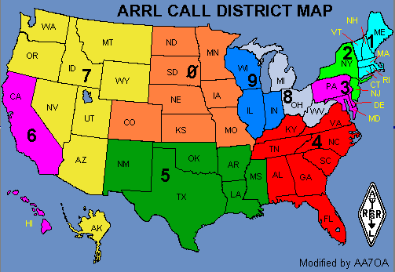
U.S. Call Districts
KH6
KL7

Slide 15
Some Common Sense Rules
No music (except from NASA)
No payment may be accepted
No profanity or obscenity allowed
  Offensive
  Young children may be listening
  Specifically prohibited in the rules
No codes or ciphers may be used
No false or deceptive signals may be transmitted
If your license expires you may no longer transmit

Slide 16
Broadcasting
Defined as “transmissions intended for reception by the general public”
Is not allowed in the amateur service

Slide 17
Sometimes we have to share!
The amateur service is a secondary user on some bands. On those bands amateurs can only transmit if they don't interfere with the primary user.
  For example, the 23 cm band is shared. If you are interfering with a radiolocation station outside the U.S. you must stop operating or take steps to eliminate the interference.
If two amateur stations want to use the same frequency they each have equal rights to that frequency.

Slide 18
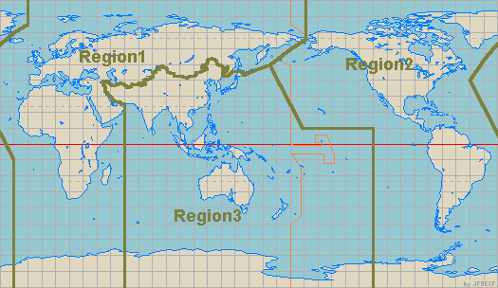
ITU Regions
Where is:
Alaska
Region 2
Guam
Region 3

Slide 19
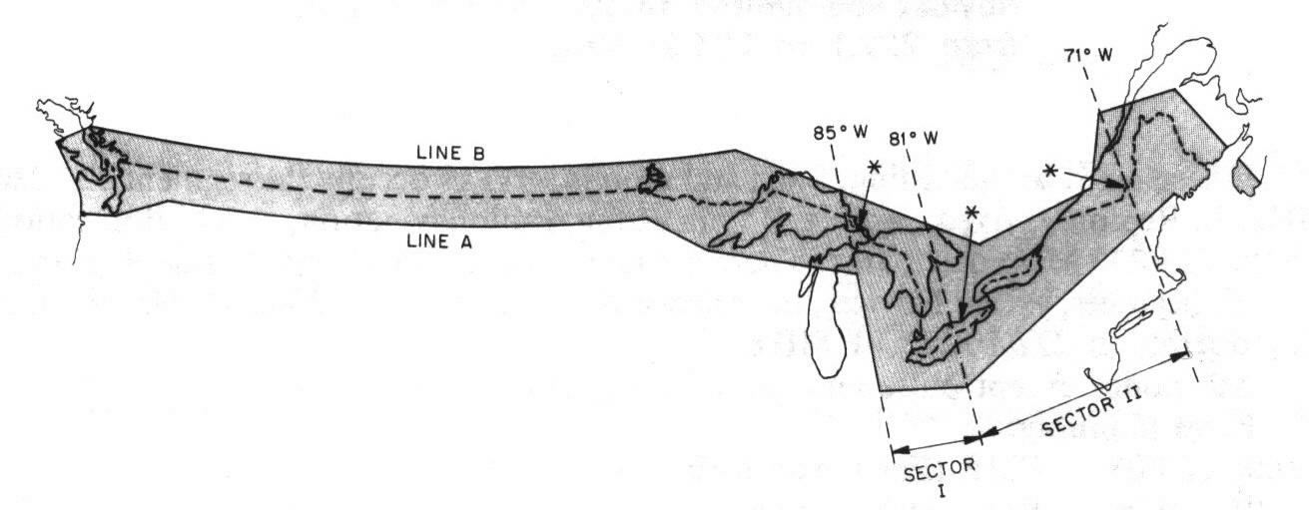
70 cm Band Restriction
The frequency limits north of “Line A” are 430 – 450 Mhz (vs. 420 – 450 Mhz elsewhere). Line A is approximately 50 miles south of the Canadian border.

Slide 20
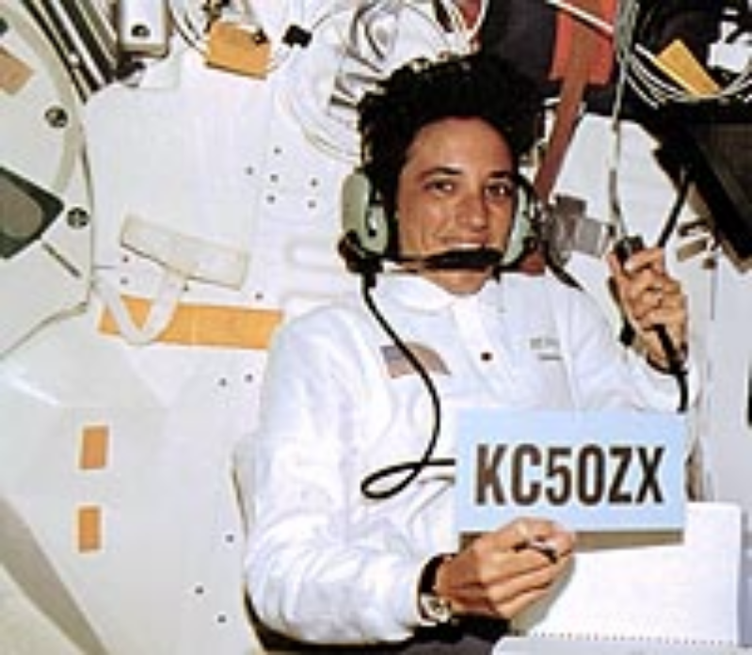
Amateur Space Station
An amateur space station is an amateur station located more than 50 km above the Earth.
An amateur space station may transmit unidentified communications.

Slide 21

T1A03
What is the definition of an amateur station?
A. A station in a public radio service used for telecommunications
B. A station using radio communications for for a commercial purpose
C. A station using equipment for training new broadcast operators and technicians
D. A station in the Amateur Radio service used for radio communications.

Slide 22
T1A13
What is a transmission called that disturbs other communications?
A. Interrupted CW
B. Harmful Interference
C. Transponder signals
D. Unidentified transmissions

Slide 23
Methods of Communication
Subelement T2

Slide 24
Alternating & Direct Current
V+
DC
0V
AC
V-
time

Slide 25
The Relationship of Frequency and Wavelength
The distance a radio wave travels in one cycle is called wavelength.
V+
One Cycle
0V
time
V-
One Wavelength

Slide 26
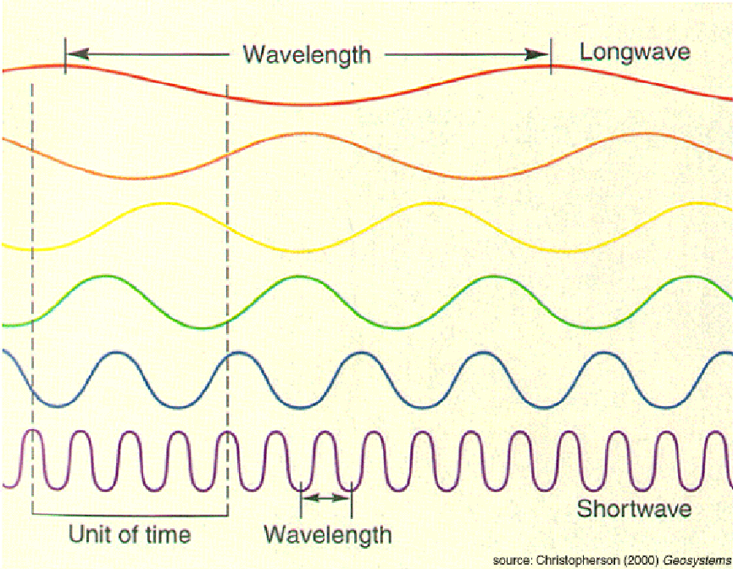
Frequency
Is a measure of the number of times (cycles) per second that an alternating current flows back and forth.
1 Second
The basic or standard unit of frequency is the Hertz.
60 hertz (Hz) means 60 cycles per second.

Slide 27
More Frequency !
A radio frequency (RF) wave is an electromagnetic oscillation or cycle that repeats more than 20,000 times per second. RF waves travel at the speed of light.
An audio-frequency signal is an electromagnetic oscillation or cycle that repeats between 20 and 20,000 times per second.
NOTE: SOUND WAVES ARE NOT ELECTROMAGNETIC!

Slide 28
Frequency & Wavelength
The distance an AC signal travels in one complete cycle is its wavelength.
As the frequency increases the wavelength gets shorter.

Slide 29
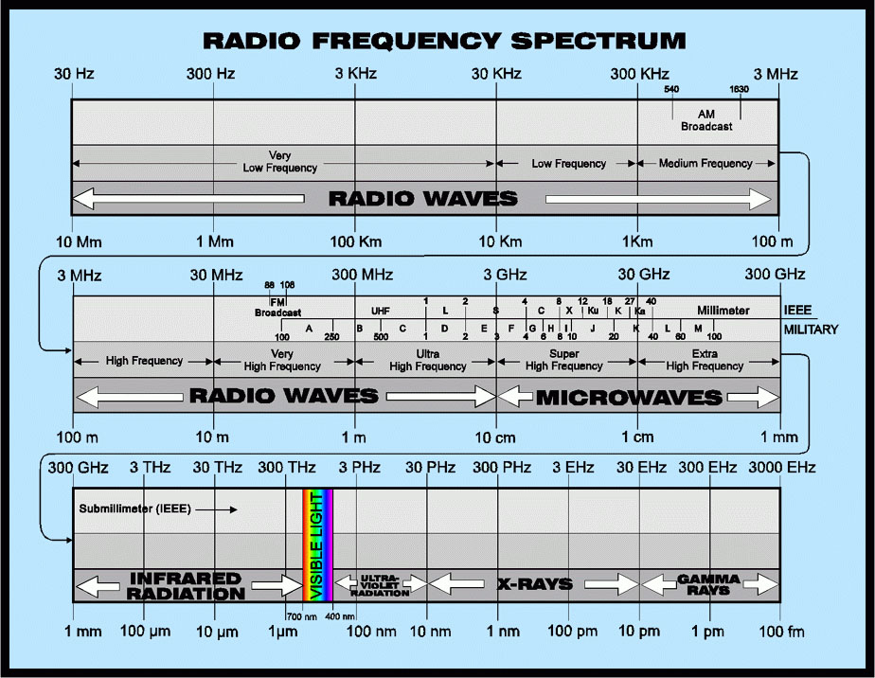
The 2-meter amateur band is in the VHF or Very High Frequency range.

Slide 30
Wavelength Formula
To convert from frequency to wavelength:
Wavelength and Frequency are Inversely Proportional. As one goes up, the other must go down.
300
freq (MHz)
Wavelength (m) =

Slide 31
Radio Frequency
A radio frequency wave may be identified by:
  Its Wavelength
  Its corresponding Frequency
  The Radio Band in which it is transmitted or received, i.e. MF, HF, VHF, UHF, etc.

Slide 32
Harmonic Frequencies
Desired Frequency
The frequency of a harmonic is exactly two, or three, or more times the desired frequency.
2nd Harmonic
3rd Harmonic
4th Harmonic
50.25
100.50
150.75
210.00
Frequency (MHz)

Slide 33
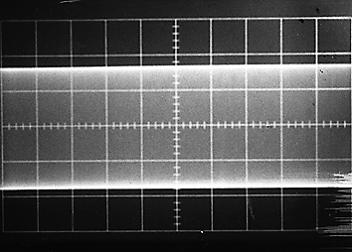
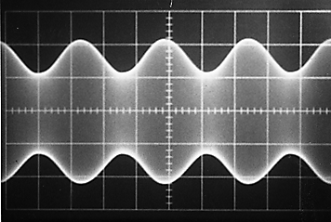
Radio Communications
The basic principle of radio communications is combining a radio wave with an information signal and transmitting it. A receiver separates the two.
Combining an information signal with a radio signal is called “Modulation”.

Slide 34

FCC Emission Types
CW
Phone
  AM (Amplitude Modulation)
  SSB (Single-sideband Modulation)
  FM (Frequency Modulation)
Data
  PSK31
  RTTY
  Other telemetry, telecommand, or computer communications

Slide 35
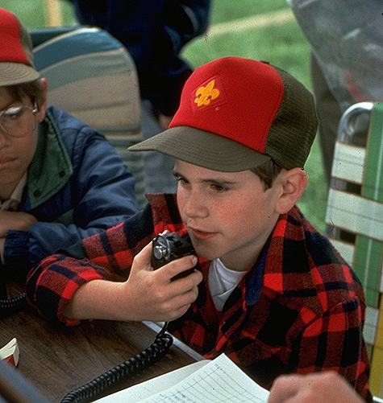
Phone Emissions
The FCC calls all types of voice emissions “Phone”.
Frequency modulated (FM) phone is most often used on VHF & UHF repeaters.
Upper sideband (USB) phone is commonly used on the 10-meter phone band.
Upper sideband phone is normally used for VHF & UHF SSB communications.

Slide 36
Data Emissions
The FCC calls telemetry, telecommand, or computer communications “Data” emissions.
Some common data emissions are packet, PSK31, and radio teletype (RTTY).
When using packet the term “connected” means sending data to only one receiving station and it replies the data is being received correctly.
PSK31 has a typical bandwidth of 31 Hz.
A Technician licensee is permitted to operate point-to-point digital message forwarding in the 219 – 220 MHz frequency range.

Slide 37

Technician w/Morse
Allowed to operate only CW from 7100 to 7150 Khz (40m band)
Allowed to operate CW and single-sideband phone from 28.3 to 28.5 Mhz (10m band)
Allowed a maximum of 200 watts PEP output power on the 10-meter band
Frequency priviledges on the 10 meter band limited to 28.100 – 28.500 MHz
Frequency priviledges on the 80 meter band limited to 3675 – 3725 kHz

Slide 38
Homework
Study Subelements T1 & T2 of the question pool.
  Read the Question and the Answer Three Times.
Read Chapters 1 & 2 in “Now You're Talking”.

